Slide 1
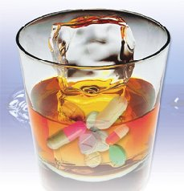
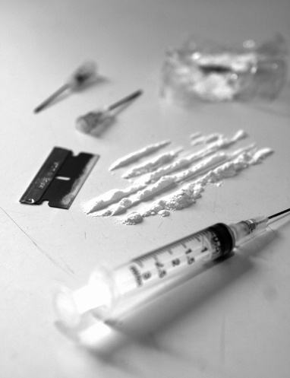



Session 24
Drug Combinations

Slide 2
Learning Objectives
Explain prevalence of polydrug impairment
Describe possible combinations of drug effects
Define terms “Null”, “Overlapping”, “Additive” and “Antagonistic”
Identify specific effects most likely to be observed
Describe novel psychoactive substances and their effects

Slide 3
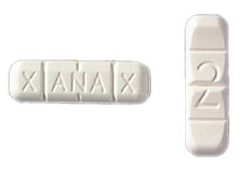
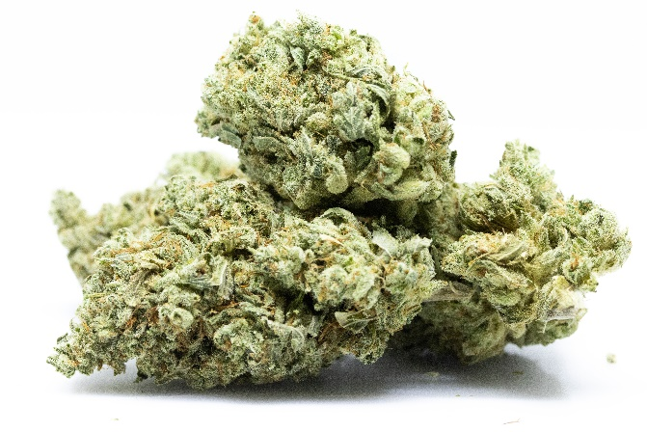
What is Polydrug Impairment?
+

Slide 4
Drug Combinations
Cocaine and Heroin – “Speedball”
PCP and Heroin – “Fireball”
Crack and PCP – “Space base”
Crack and Marijuana – “Primo”
Xanax and Methamphetamine

Slide 5
Effects of Drug Combinations on Indicators of Impairment
Null Effect
Overlapping Effect
Additive Effect
Antagonistic Effect

Slide 6
Null Effect
No action
+
No action
=
No action

Slide 7
Null Effect
Example #1:
HGN
Narcotic Analgesic and Cannabis
Example #2:
Reaction to Light
Dissociative Anesthetics and Cannabis

Slide 8
Overlapping Effect
+
No action
=
Action
Action

Slide 9
Overlapping Effect
Example #1:
Pupil Size
CNS Stimulants and Dissociative Anesthetics
Example #2:
HGN
CNS Depressants and Narcotic Analgesics

Slide 10
Additive Effect
+
=
Action
Action
Greater Action

Slide 11
Additive Effect
Example #1:
Pulse Rate
Cannabis and Inhalants
Example #2:
Pupil Size
CNS Stimulants and Hallucinogens

Slide 12
Antagonistic Effect
+
Opposite Action
=
Action
Unpredictable

Slide 13
Antagonistic Effect
Example #1:
Pulse Rate
CNS Stimulants and CNS Depressants
Example #2:
Pupil Size
CNS Stimulants and Narcotic Analgesics

Slide 14
Antagonistic Effect
Example #3:
Blood Pressure
Hallucinogens and Narcotic Analgesics

Slide 15
Cannabis and CNS Stimulant
Impairment Indicator | Cannabis | CNS Stimulant | Type of Effect | What Should We See?
HGN | None | None | Null | No HGN
VGN | None | None | Null | No VGN
LOC | Present | None | Overlapping | LOC
Pupil Size | Dilated ⁽⁶⁾ | Dilated | Overlapping or Additive | Dilated
Reaction to Light | Normal | Slow | Overlapping | Slow
⁽⁶⁾ Pupil Size Possibly Normal.

Slide 16
Cannabis and CNS Stimulant
Impairment Indicator | Cannabis | CNS Stimulant | Type of Effect | What Should We See?
Pulse Rate | Up | Up | Additive | Up
Blood Pressure | Up | Up | Additive | Up
Body Temperature | Normal | Up | Overlapping | Up
Muscle Tone | Normal | Rigid | Overlapping | Rigid

Slide 17
Dissociative Anesthetic and Narcotic Analgesic
Impairment Indicator | Dissociative Anesthetic | Narcotic Analgesic | Type of Effect | What Should We See?
HGN | Present | None | Overlapping | HGN
VGN | Present | None | Overlapping | VGN
LOC | Present | None | Overlapping | LOC
Pupil Size | Normal | Constricted | Overlapping | Constricted

Slide 18
Dissociative Anesthetic and Narcotic Analgesic
Impairment Indicator | Dissociative Anesthetic | Narcotic Analgesic | Type of Effect | What Should We See?
Reaction to Light | Normal | Little or None Visible | Overlapping | Little or None Visible
Pulse Rate | Up | Down | Antagonistic | Up, Down or Normal
Blood Pressure | Up | Down | Antagonistic | Up, Down or Normal

Slide 19
Dissociative Anesthetic and Narcotic Analgesic
Impairment Indicator | Dissociative Anesthetic | Narcotic Analgesic | Type of Effect | What Should We See?
Body Temperature | Up | Down | Antagonistic | Up, Down or Normal
Muscle Tone | Rigid | Flaccid | Antagonistic | Normal, Rigid, or Flaccid

Slide 20
Cannabis, CNS Stimulant, and Hallucinogen
Impairment Indicator | Cannabis | CNS Stimulant | Hallucinogen | Type of Effect | What Should We See?
HGN | None | None | None | Null | No HGN
VGN | None | None | None | Null | No VGN
LOC | Present | None | None | Overlapping | LOC
Pupil Size | Dilated ⁽⁶⁾ | Dilated | Dilated | Additive/ Overlapping ⁽⁶⁾ | Dilated
⁽⁶⁾ Pupil size possibly normal

Slide 21
Cannabis, CNS Stimulant, and Hallucinogen
Impairment Indicator | Cannabis | CNS Stimulant | Hallucinogen | Type of Effect | What Should We See?
Reaction to Light | Normal | Slow | Normal ⁽³⁾ | Overlapping/ Additive ⁽³⁾ | Slow
Pulse Rate | Up | Up | Up | Additive | Up
Blood Pressure | Up | Up | Up | Additive | Up
⁽³⁾ Certain psychedelic amphetamines may cause slowing

Slide 22
Cannabis, CNS Stimulant, and Hallucinogen
Impairment Indicator | Cannabis | CNS Stimulant | Hallucinogen | Type of Effect | What Should We See?
Body Temperature | Normal | Up | Up | Additive/ Overlapping | Up
Muscle Tone | Normal | Rigid | Rigid | Additive/ Overlapping | Rigid

Slide 23
Identifying Expected Indicators of Specific Combinations
The Drug Symptomatology Matrix outlines the expected results of the drug influence evaluation for each drug category.

Slide 24
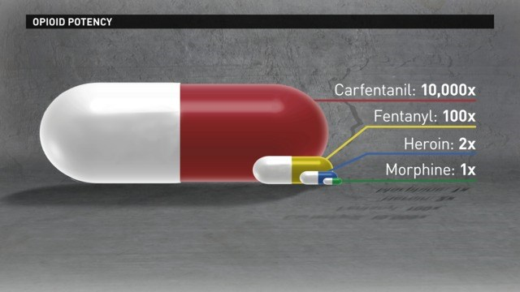
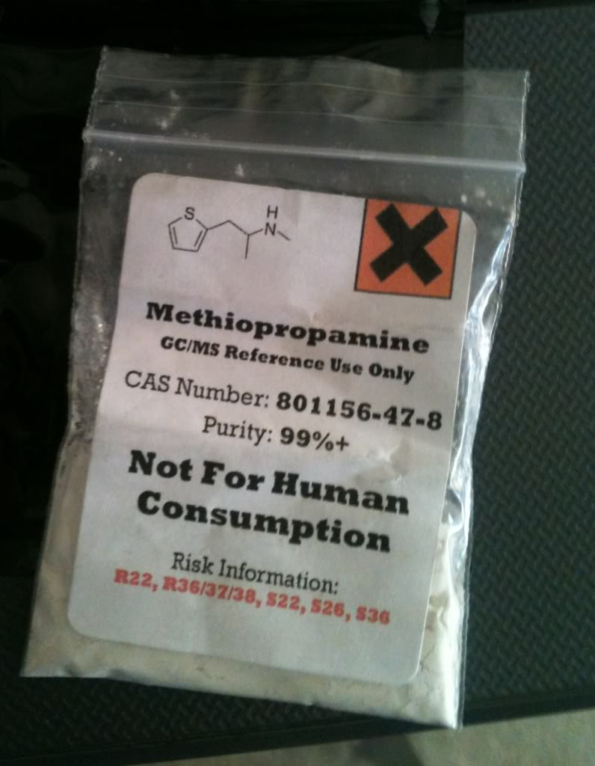
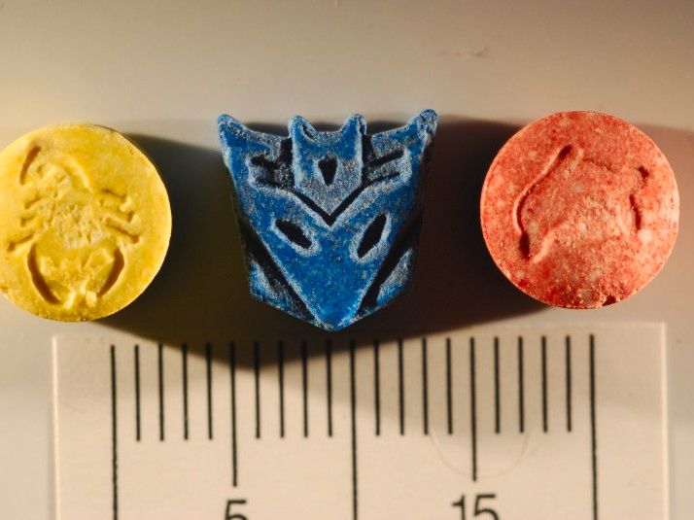
Novel Psychoactive Substances
Synthetic Opioids
Novel Stimulants
Novel Tryptamine Derivates

Slide 25
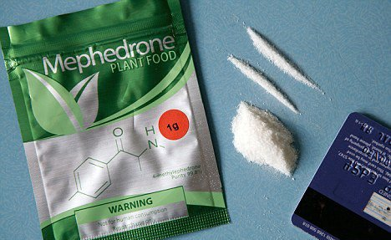
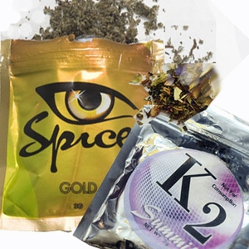
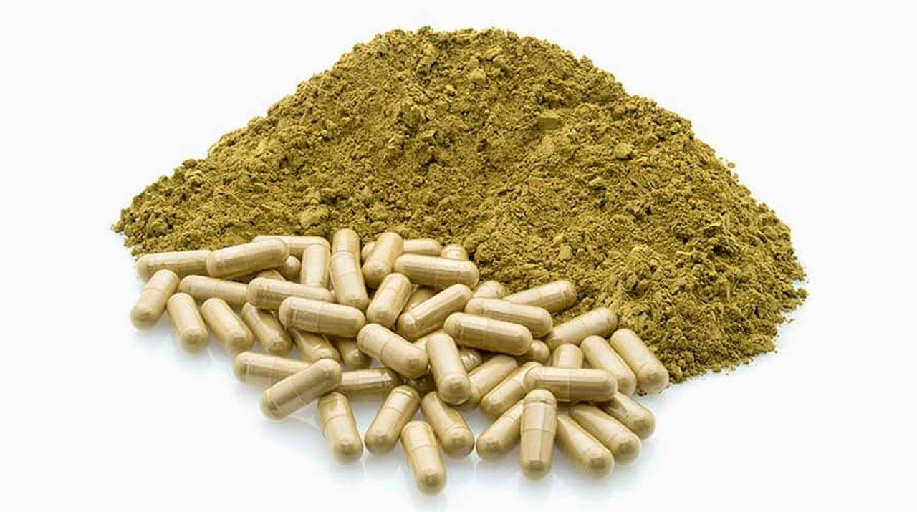
Novel Psychoactive Substances
Synthetic Cathinones
Novel Stimulants
Kratom

Slide 26
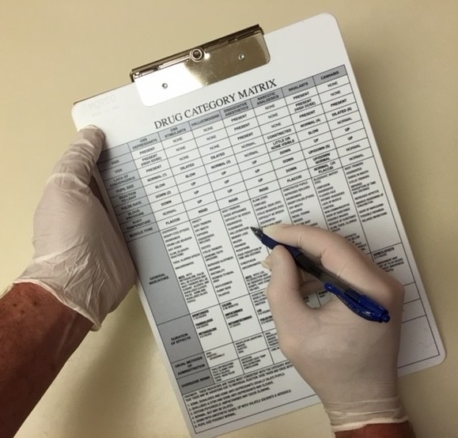
Novel Psychoactive Substances Call What You See!

Slide 27
Worksheets

Slide 28
Questions?

